Slide 1
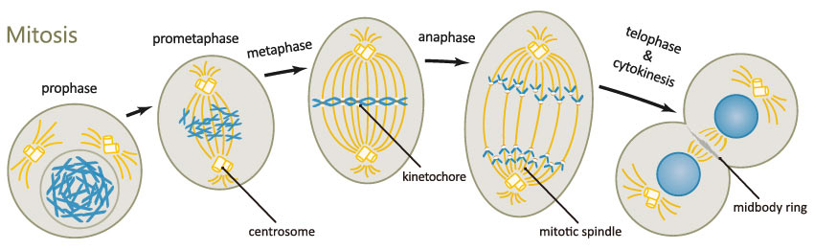
The Cell Cycle (and Mitosis)
Chapter 12

Slide 2
DNA Review
Monomer?
Parts of the monomer?
Complementary Base pairing?
Double Stranded or Single Stranded?
Antiparallel strands?

Slide 3
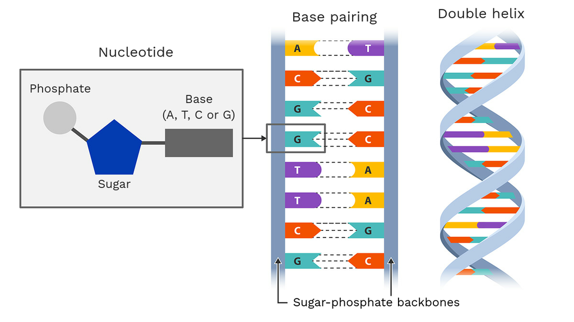

Slide 4
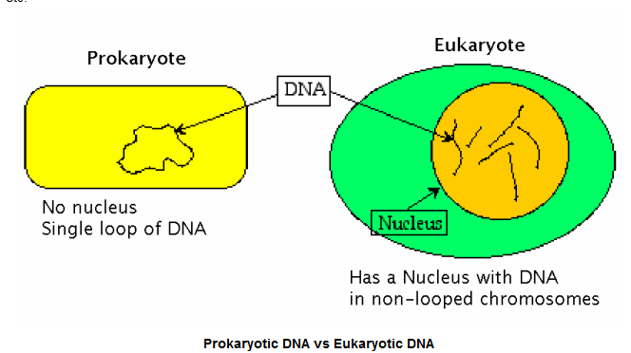
What is DNA?
DNA carries hereditary information (genes)
DNA is organized into units called chromosomes
  Prokaryotes have one circular chromosome
  Eukaryotes have multiple, linear chromosomes

Slide 5
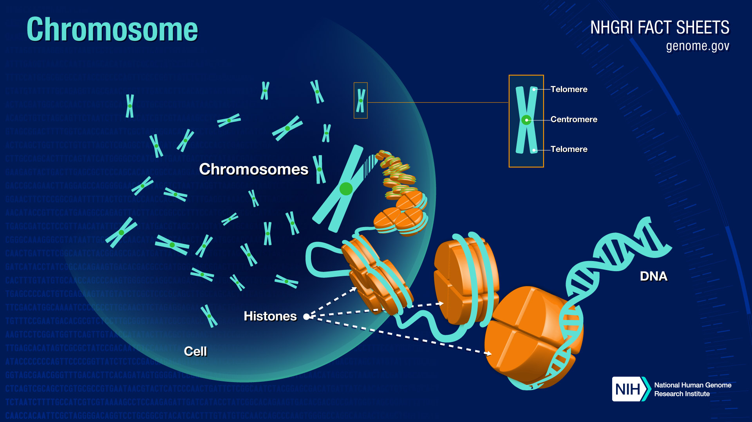
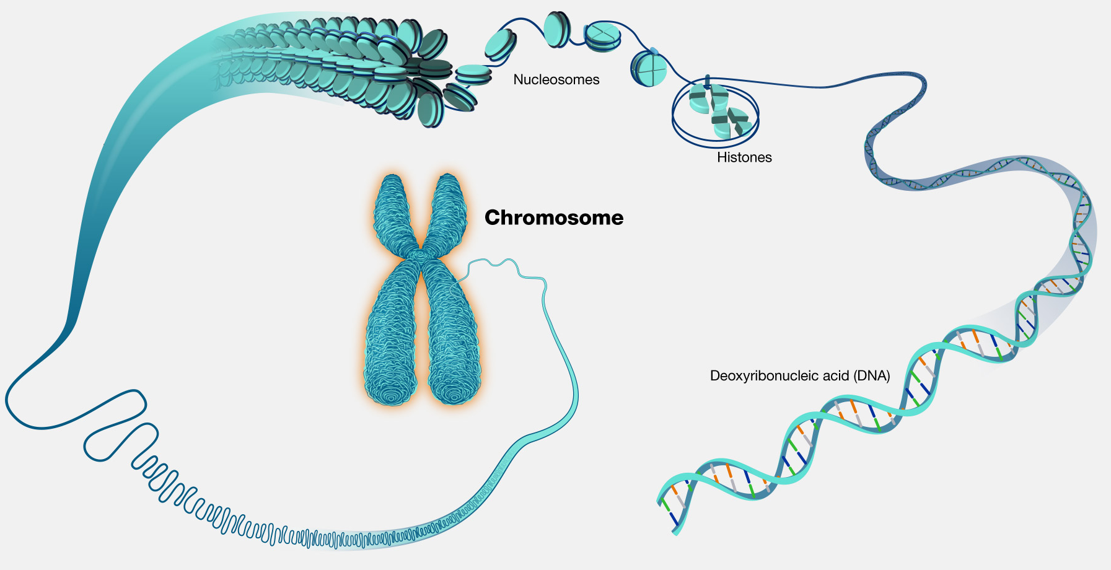
Chromosomes
Darryl Leja

Slide 6
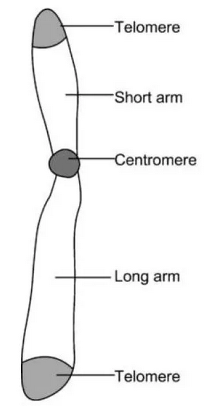
Eukaryotic Chromosome Structure:
  Centromere
    The “waist” of the chromosome
    Where kinetochore attaches
  Chromosome arms
    One above and one below centromere
  Telomeres
    Protective “caps” at both ends of chromosome

Slide 7
Chromosomes
Each species has a specific number of chromosomes
  Humans have 46 chromosomes
  Dogs have 78 chromosomes
  Atlas blue butterfly has 448!
Number of chromosomes is not correlated to intelligence, complexity, etc.
Sometimes unrelated species have the same number of chromosomes
  Ex. Grevy’s zebra also have 46 chromosomes
But species that are closely related to each other have similar chromosomal numbers
  Chimpanzees, our closest living relatives, have 48 chromosomes
  Horses have 64 chromosomes and donkeys have 62

Slide 8
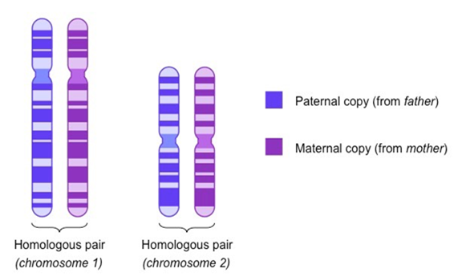
Homologous chromosomes
Eukaryotic cells have two copies of each chromosome
  1 chromosome from mother
  1 chromosome from father
  Called homologous chromosomes (homologs)
    Example: Chromosome 1 from mom and chromosome 1 from dad are a homologous pair

Slide 9
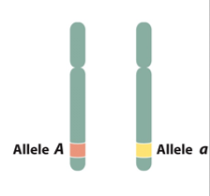
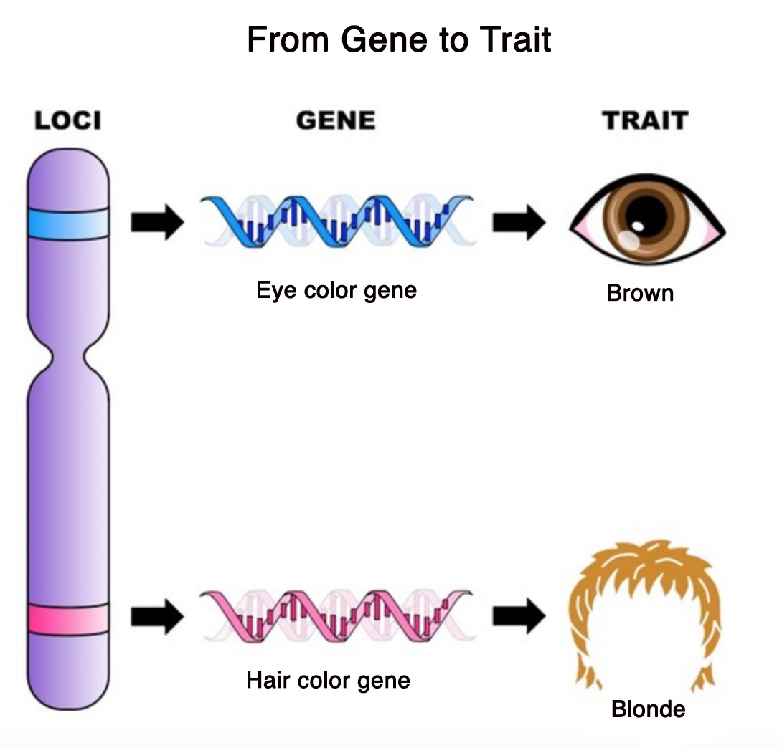
Homologous chromosomes
Homologs: Contain same gene character but may have different traits
  Example: Chromosome 1 contains the gene for ear shape in dogs
    Chromosome 1 from mom has “floppy” ear trait
    Chromosome 1 from dad has “upright” eat trait

Slide 10


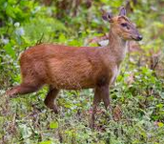

Female muntjac’s have six chromosomes. Try to pair these chromosomes into three pairs of homologous chromosomes.
3
1
5
6
2
4

Slide 11
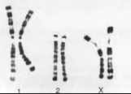
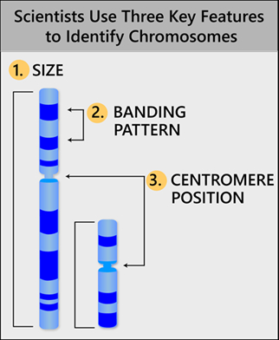
Here are the three pairs of homologous chromosomes. Notice the size and banding pattern.
Also, take note to see if the banding pattern is identical in each pair of homologs.

Slide 12



Slide 13
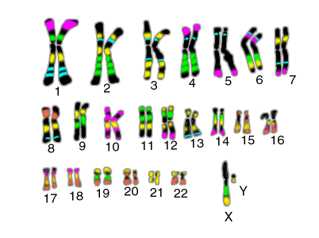

Slide 14
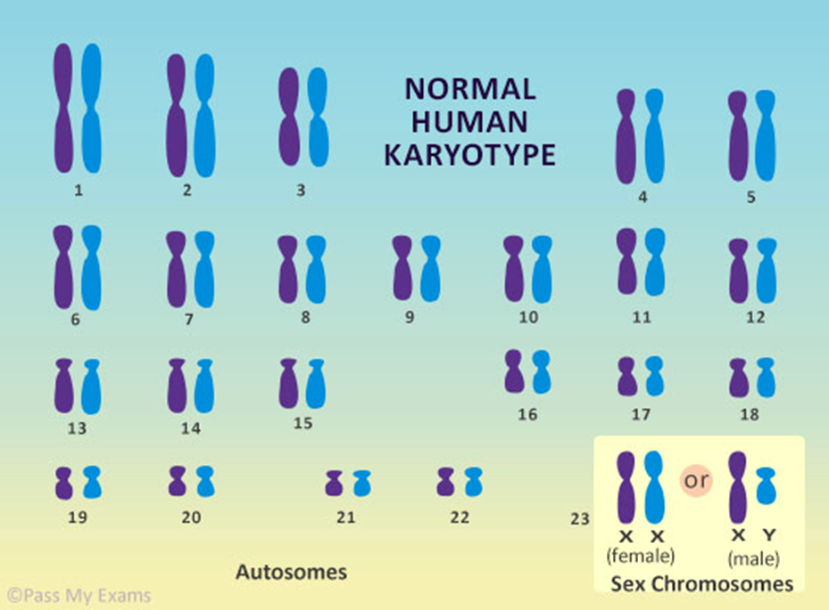
Human Karyotype
A Karyotype displays homologous chromosomes arranged by size
46 chromosomes
  23 pairs
    1 chromosome of the pair from the mother
    1 chromosome of the pair from the father
Pairs 1-22 are autosomes
  Do not determine sex of offspring
The 23rd pair are sex chromosomes, X and Y
  Females are XX
  Males are XY

Slide 15
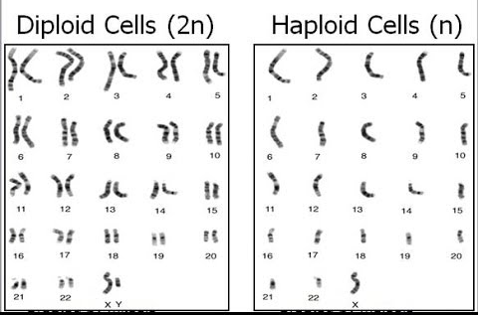
Different cell types have different numbers of chromosomes
Somatic cells
  Body cells
    Skin cells, liver cells, brain cells, etc.
  Diploid (2n)
    Contain both copies of each chromosome
Gametes
  Egg and sperm (reproductive cells)
  Haploid (n)
    Contain only one copy of each chromosome
    Why?

Slide 16
Homologous chromosomes
The diploid number (2n) refers to # of chromosomes in somatic cells
Each cell contains both copies of each chromosome
  Humans: 2n = 46 (how many pairs of chromosomes?)
  Dogs: 2n = 78 (how many pairs of chromosomes?)
  Blue Atlas butterfly: 2n = 448 (how many pairs of chromosomes?)
So, what is the haploid (n) number for each above?
  Humans: n = ___
  Dogs: n = ___
  Blue Atlas butterfly: n = ___
Which cells have haploid number (n) of chromosomes?

Slide 17
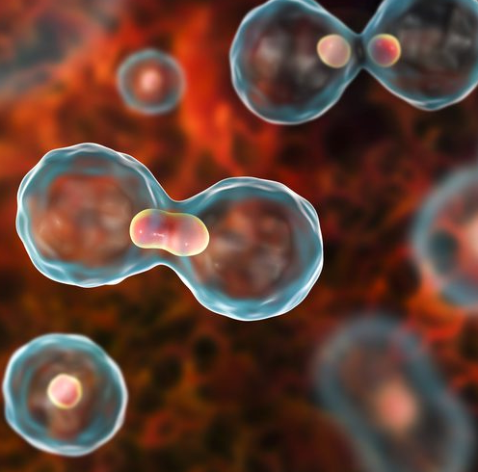
Cell Theory
The cell is the basic unit of life
All living organisms are composed of one or more cells
All new cells arise from existing cells
Why do cells need to divide?
How does one cell give rise to other cell(s)?
How does the cell divide the DNA, organelles, plasma membrane, etc?
  Especially DNA! Why is it important to divide DNA properly?

Slide 18
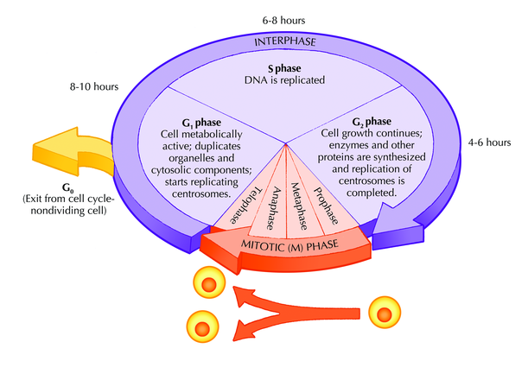
The Cell Cycle
Two phases:
  Interphase
    Longest phase of cell cycle
    When cell needs to divide, it begins getting ready in Interphase
      DNA is replicated during this phase
        Need 2x the DNA
      Additional cytoplasmic components synthesized during this phase
        Need additional organelles
      Cell grows
        Need extra plasma membrane
  Mitotic phase
    DNA and cytoplasm are divided during this phase
      Need to split DNA equally between the two new “daughter” cells
    Forms two genetically identical daughter cells

Slide 19
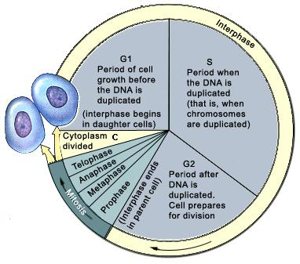
Interphase
Divided into three sub-phases:
G1: Gap₁ phase (“first gap”)
  Growth occurs when cell receives signal to divide
S phase (“synthesis”)
  DNA is replicated (synthesized)
  Centrosome is replicated
G2: Gap₂ phase (“second gap”)
  Growth continues
  Cell prepares to divide

Slide 20
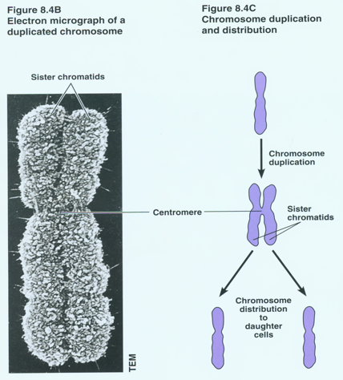
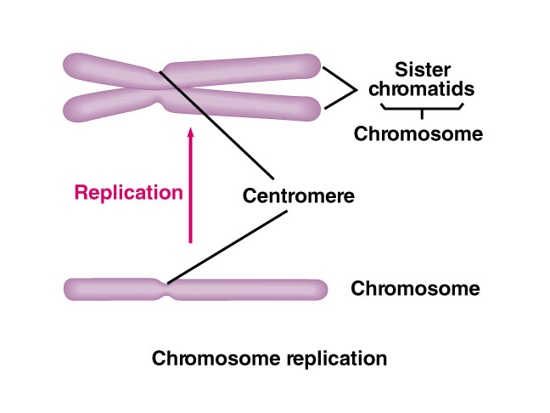
DNA Synthesis (replication)
DNA must be replicated prior to cell division
After DNA synthesis, each chromosome is comprised of two sister chromatids joined together at the centromere
  Cohesion proteins bind them together

Slide 21
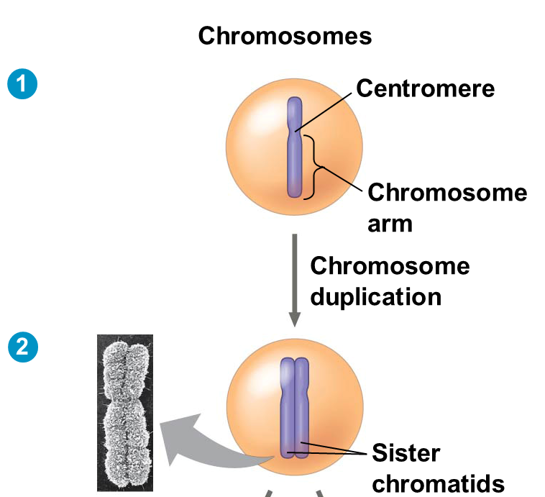
Sister Chromatids
Before cell division, chromosomes are copied, creating Sister Chromatids
Sister Chromatids
  Sister chromatids are joined at centromere
  Sister chromatids are identical to each other
    The exact DNA sequence is copied during S phase

Slide 22
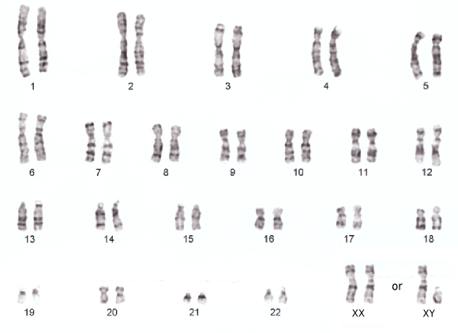
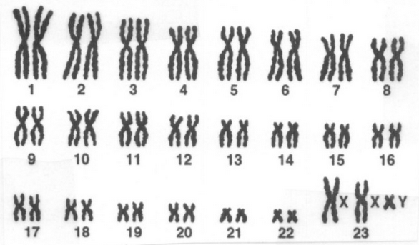
Human Karyotype before and after DNA Synthesis

Slide 23
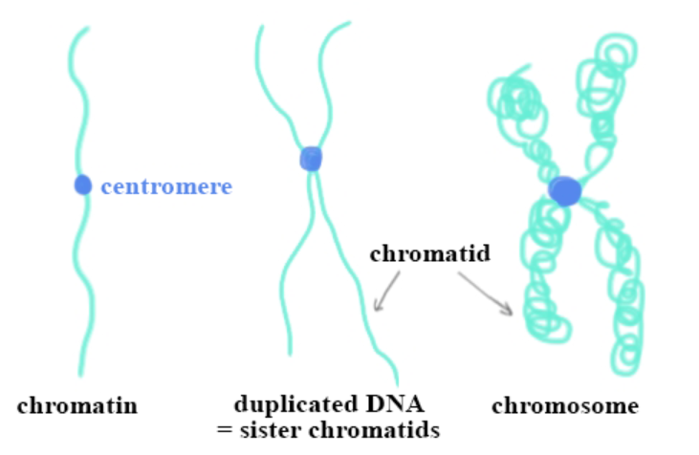
Vocab
Before duplication:
  chromosome (singular arm)
  chromosomes/homologs/homologous pair
Prepping for cell division
  Chromatin: condensed chromosome
Interphase/Duplication
  Sister chromatids: condensed and paired

